Slide 1
Anesthetic risk assessment
Assist. Prof. Dr. Rafid Majeed Naeem

Slide 2
Anesthetic risk assessment
perioperative assessment of anesthetic risk is a valuable exercise in order to minimize complications and optimize anesthetic safety.
preoperative patient risk assessment
Patient health assessment
The preoperative assessment of an animal’s health status is valuable
1. to acknowledge preanesthetic risks,
2. to identify management priorities
3. to advise clients appropriately prior to anesthesia and surgery

Slide 3
Patient health assessment
Pre‐existing cardiopulmonary pathology
Hematologic and biochemical abnormalities
Renal disease
Neurologic disease

Slide 4
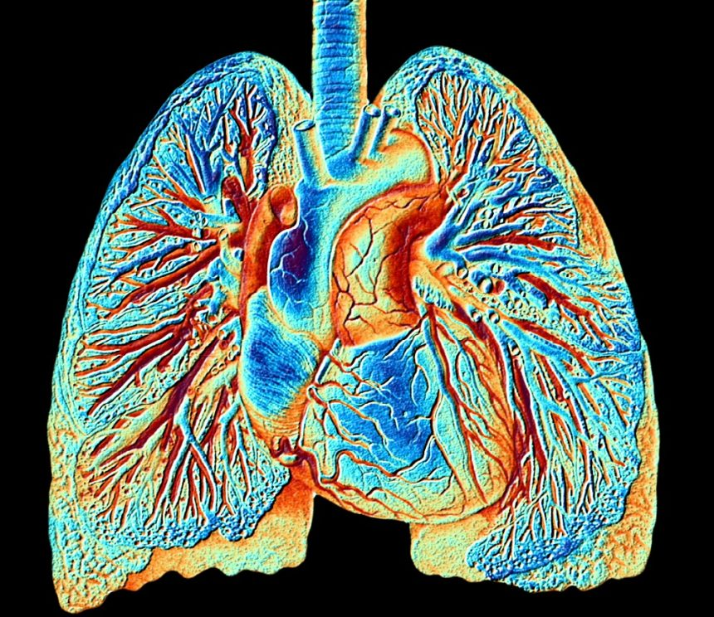
1. Pre‐existing cardiopulmonary pathology
Anesthetic agents cause cardiopulmonary depression and the presence of pre‐existing pathology is likely to predispose to greater anesthetic‐induced physiologic disturbance and may considered as anesthetic‐related mortality
تسبب عوامل التخدير الاكتئاب القلبي الرئوي ومن المرجح أن يؤدي وجود أمراض موجودة مسبقًا إلى حدوث اضطرابات فسيولوجية ناتجة عن التخدير وقد تعتبر بمثابة وفيات مرتبطة بالتخدير

Slide 5
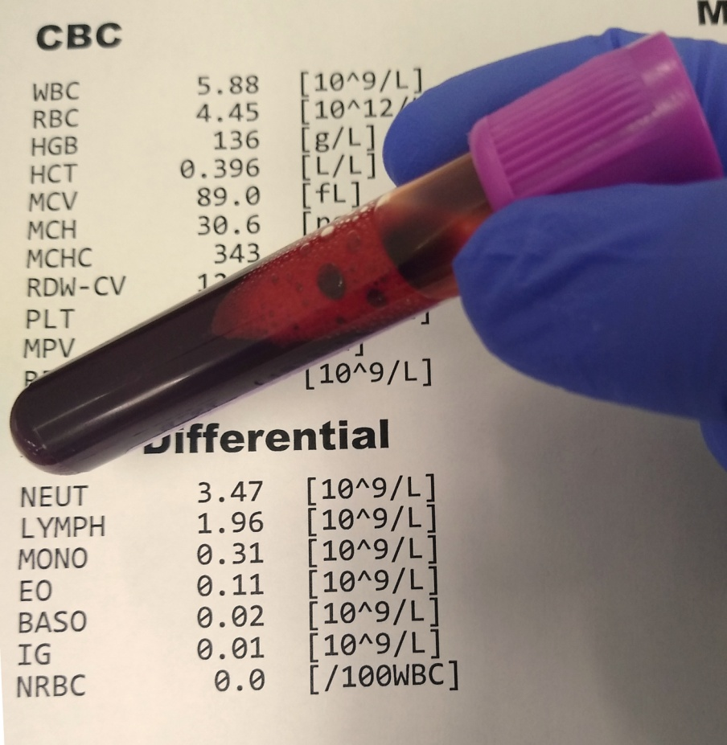
2. Hematologic and biochemical abnormalities In particular,
anemia will reduce oxygencarrying capacity and predispose to hypoxia, and
hypoproteinemia has been theorized to increase the response of the patient to highly protein‐bound drugs and result in relative overdose.
the laboratory biochemical or hematologic results are useful for
a. identifying that surgery should be postponed
b. Changing anesthetic protocol,
c. undiagnosed pathology may be detected prior to anesthesia using ‘routine’ screening may usefull for whether the owner decides to proceed with anesthesia/surgery

Slide 6
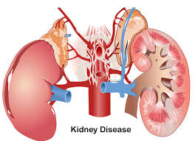
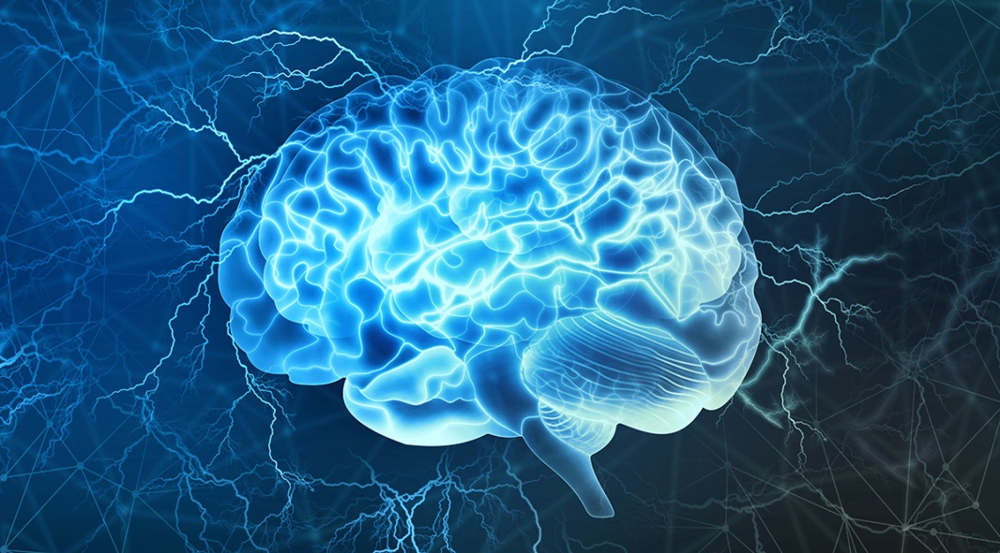
3. Renal disease is also important, if dehydration or uremia is present
4. Neurologic disease the occurrence of postoperative seizures, increased sensitivity to anesthetics

Slide 7
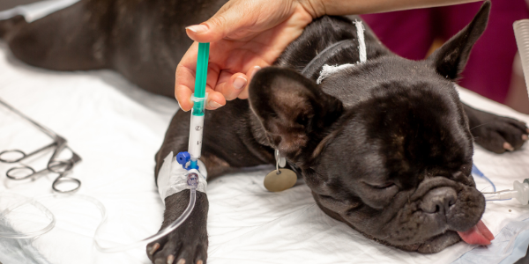
Morbidity and mortality
Nonfatal complications tend to occur more frequently than mortal events.
Small animal anesthesia morbidity:
are non‐fatal complications which include
Respiratory complications
cardiovascular complications
gastrointestinal,
thermoregulatory,
Poor recoveries

Slide 8
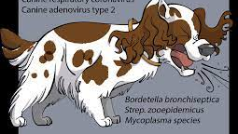
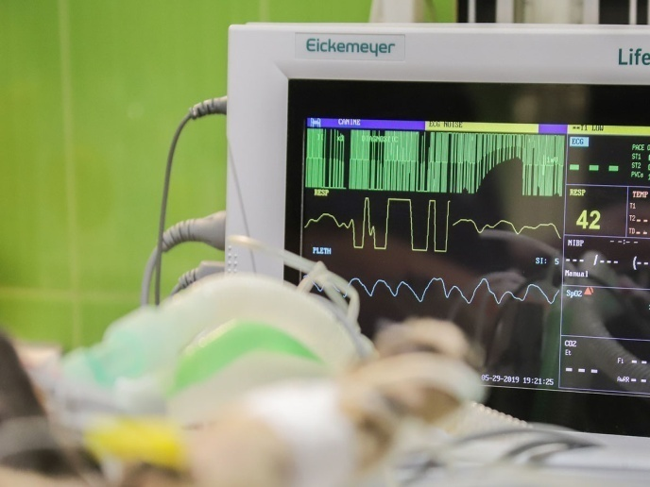
Respiratory complications included respiratory depression or apnea, respiratory distress, and difficulty with intubation, hypoventilation and hypercapnia and hypoxemia , occasionally airway compromise
تضمنت المضاعفات التنفسية تثبيط الجهاز التنفسي أو انقطاع النفس ، وضيق التنفس ، وصعوبة التنبيب ، ونقص التهوية ، وفرط ثنائي أكسيد الكربون في الدم ، ونقص الأكسجة في الدم ، وفي بعض الأحيان اختلال في مجرى الهواء
2. cardiovascular complications were hypotension and cardiac arrhythmias notably bradycardia
كانت مضاعفات القلب والأوعية الدموية هي انخفاض ضغط الدم وعدم انتظام ضربات القلب بشكل خاص بطء القلب

Slide 9
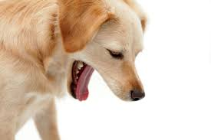
3. Regurgitation was the most frequently documented perioperative gastrointestinal complication.
The risk of gastroesophageal reflux, which may result in esophageal mucosa injury
4. Hypothermia, was a particularly common complication.
5. Poor recoveries have also been documented, often recorded as prolonged return to consciousness.

Slide 10
Large animal anesthesia morbidity (non‐fatal complications)
1. Cardiovascular compromise (same as small animals)
2. Respiratory …hypoventilation and hypercapnia and hypoxemia
على نقص التهوية وفرط ثنائي أكسيد الكربون ونقص الأكسجة في الدم
3. In contrast to small animal anesthesia, horses appear to demonstrate a wider range of postoperative complications, including fractures and soft tissue injury like myopathy, and neuropathy and many result in death or euthanasia.
على عكس التخدير الحيواني الصغير ، يبدو أن الخيول تظهر نطاقًا أوسع من مضاعفات ما بعد الجراحة ، بما في ذلك الكسور وإصابة الأنسجة الرخوة ، والاعتلال العضلي ، والاعتلال العصبي ويؤدي العديد منها إلى الموت أو القتل الرحيم.
4. postanesthetic colic

Slide 11
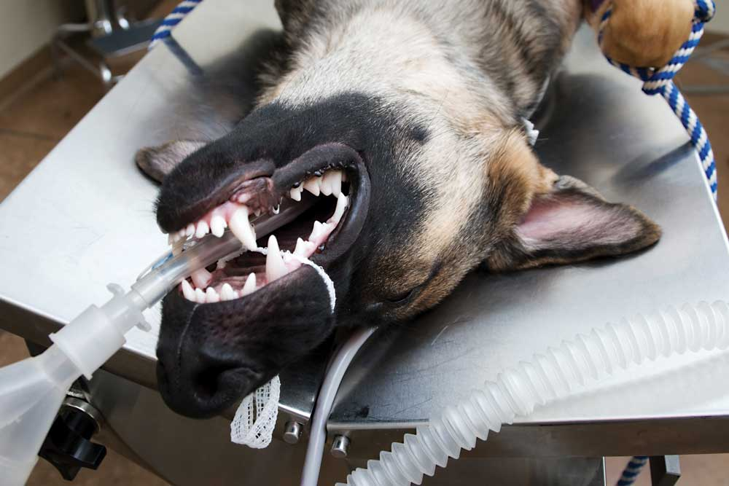
Small animal anesthetic fatalities
Causes of anesthetic death
The cause of anesthetic deaths:
cardiovascular and respiratory complications represent the primary causes of many perioperative deaths.
. Other causes:
postoperative renal failure,
aspiration of gastric contents,
anaphylactic reactions,
failure to regain consciousness,
unknown causes

Slide 12
Cardiac arrest has been reported to result from cardiac arrhythmias associated with: increased circulating catecholamines, myocardial hypoxia, specific anesthetic agents, pre‐existing pathology, and myocardial depression due to relative anesthetic overdose.
Halothane, ether, and thiobarbiturate anesthesia were frequently associated with anesthetic overdose in earlier work.
2. Respiratory complications represented the other main cause of anesthetic‐related death .
Problems related to endotracheal intubation and respiratory obstruction represented the majority of feline respiratory causes of death.
In dogs, complications with endotracheal intubation and respiratory failure were equally reported, although in brachycephalic dogs respiratory obstruction was the principal cause of respiratory complications.

Slide 13
Timing of death
Death may occurred
during induction,
during maintenance of anesthesia
the majority during recovery.
the postoperative period represented a high‐risk time and close monitoring and management until full recovery is observed are to be recommended.

Slide 14
Risk factors for anesthetic death
1. brachycephalic, terrier, and spaniel breeds in dogs were frequently represented amongst the fatalities.
2. Old age and poor health status
3. increasing duration of the procedure
4. Pre‐existing pathology
5. procedural urgency
6. extremes of weight (risks associated with obesity)
7. endotracheal intubation
8. excessive administration of fluids and fluid overload.

Slide 15
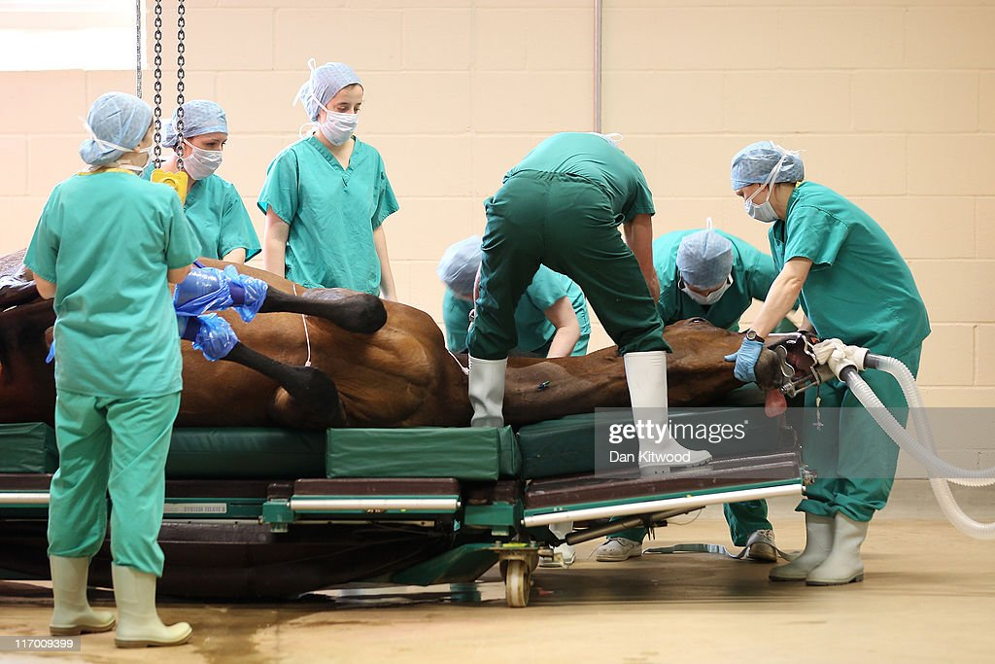
Large animal anesthetic mortality Risk of anesthetic death
Many of these fatalities due to horses undergoing emergency gastrointestinal surgery that high‐risk patients

Slide 16
Causes of anesthetic death
In equine anesthesia, cardiac arrest and cardiovascular collapse were major causes of death,
Respiratory complications
Non‐cardiopulmonary causes: fractures on recovery, postoperative myopathy, and abdominal complications such as sepsis and colitis.
Rarely have horses been reported ‘found dead’ or dying of unknown cause, perhaps because horses are more closely observed on recovery than many small animal patients.

Slide 17
Timing of anesthetic death
the postoperative period as a major period of risk, although intraoperative concerns remain important, close attention to the postoperative period is also important in equine anesthesia.

Slide 18
commonly reported risk factors associated with death
The work in equine anesthesia indicates risk factors include
1. emergency,
2. abdominal, and orthopedic surgery,
3. long operations,
4. poor health status,
5. extremes of age
Informed consent موافقة مسبقة
the successful communication of these risks to owners and clients is central to the provision of safe anesthesia and the maintenance of realistic owner expectations.
يعتبر التواصل الناجح لهذه المخاطر مع المالكين والعملاء أمرًا محوريًا لتوفير التخدير الآمن والحفاظ على توقعات واقعية للمالك.

Slide 19
Muscle Relaxants and Neuromuscular Blockade
Muscle relaxants are a group of anesthetic adjuncts administered to improve relaxation of skeletal muscles during surgical or diagnostic procedures
مرخيات العضلات هي مجموعة من مساعدات التخدير التي تُحقن لتحسين استرخاء عضلات الهيكل العظمي أثناء العمليات الجراحية أو التشخيصية.
The neuromuscular blocking agents (NMBAs) action at the neuromuscular junction.
The more general term muscle relaxant refers to any drug having relaxant properties and would include centrally acting agents such as benzodiazepines, α2‐adrenergic receptor agonists
يشير مصطلح مرخي العضلات الأكثر عمومية إلى أي دواء له خصائص مرخية وسيشمل عوامل تعمل مركزياً مثل البنزوديازيبينات ، منبهات مستقبلات α2 ‐ الأدرينالية

Slide 20
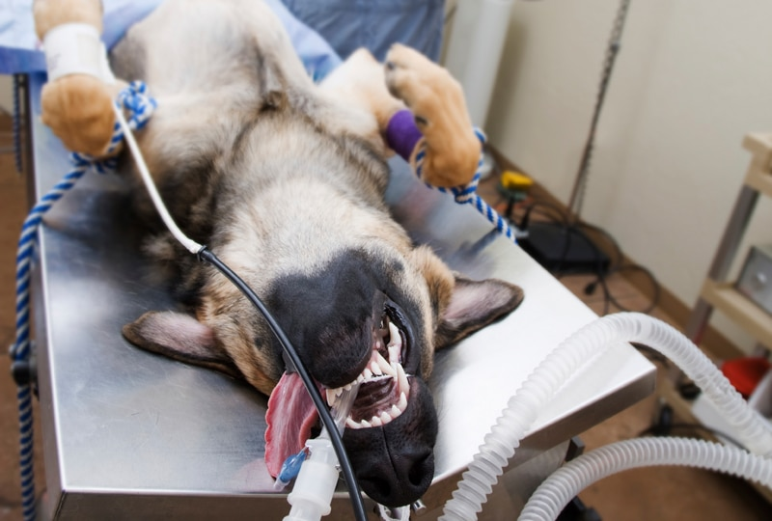
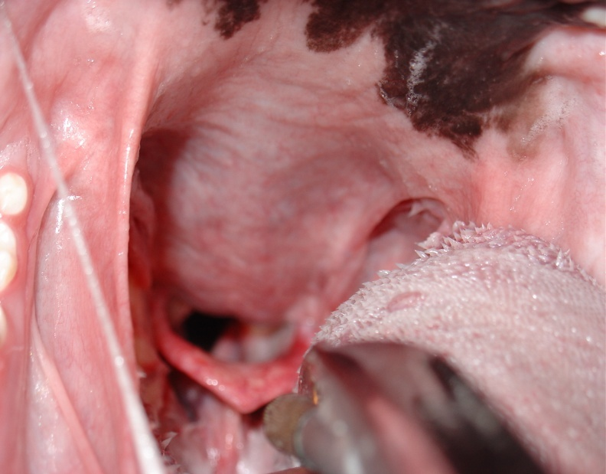
Beneficial effects of NMBA administration during general anesthesia include
facilitation of tracheal intubation
reduction of skeletal muscle tone at light planes of inhalant or injectable anesthesia,
prevention of patient movement during delicate ocular, neurologic, or cardiothoracic surgery
the use of NMBAs in general veterinary practice is limited.

Slide 21
مهم triad of anesthesia
Inhalant anesthetics such as isoflurane are complete anesthetics in that they fulfill the ‘triad of anesthesia’; that is, they provide unconsciousness, analgesia, and muscle relaxation. All three of these properties are required to permit most invasive surgical procedures.
إن أدوية التخدير المستنشقة مثل الأيزوفلورين هي أدوية تخدير كاملة من حيث أنها تحقق "ثالوث التخدير" ؛ أي أنها توفر فقدان الوعي ، والتسكين ، واسترخاء العضلات. كل هذه الخصائص الثلاثة مطلوبة للسماح بمعظم الإجراءات الجراحية الغازية

Slide 22
, inhalant anesthetics are very good at producing loss of consciousness at comparatively light planes of anesthesia while substantially deeper planes are required to provide analgesia and muscle relaxation
تعتبر أدوية التخدير عن طريق الاستنشاق جيدة جدًا في إحداث فقدان للوعي في مستويات التخدير الخفيفة نسبيًا بينما تتطلب مستويات أعمق إلى حد كبير توفير التسكين واسترخاء العضلات
Unfortunately, deeper planes of inhalant anesthetics are associated with a decrease in cardiovascular function, thus the properties of muscle relaxation and analgesia are accompanied by the adverse effect of reduced cardiovascular performance.
. لسوء الحظ ، ترتبط المستويات العميقة من أدوية التخدير الاستنشاقي بانخفاض في وظائف القلب والأوعية الدموية ، وبالتالي فإن خصائص استرخاء العضلات وتسكين الألم مصحوبة بالتأثير الضار لتقليل أداء القلب والأوعية الدموية.

Slide 23
Rather than using an inhalant anesthetic to provide all three components of the triad, a safer, smoother anesthetic technique, particularly in patients with cardiovascular compromise, may be one that uses:
low concentrations of inhalant anesthetic to provide unconsciousness,
opioids to provide analgesia, and
a NMBA to provide muscle relaxation.
Techniques such as this may be termed balanced anesthesia
.
Balanced anesthesia techniques are frequently chosen because they provide optimal conditions for both the surgeon and the patient
كثيرًا ما يتم اختيار تقنيات التخدير المتوازن لأنها توفر الظروف المثلى لكل من الجراح والمريض.

Slide 25
Individual neuromuscular blocking drugs
The NMBAs are quaternary ammonium compounds designed to mimic the quaternary nitrogen atom of ACh. They bind to the cholinergic receptors at the motor endplate as well as to cholinergic receptors located in autonomic ganglia.
أدوية الحصر العصبي العضلي الفردية
إن NMBAs عبارة عن مركبات أمونيوم رباعية مصممة لتقليد ذرة النيتروجين الرباعية لـ ACh. ترتبط بالمستقبلات الكولينية في اللوح الحركي وكذلك بالمستقبلات الكولينية الموجودة في العقد اللاإرادية.
Succinylcholine
Succinylcholine is currently the only depolarizing NMBA used clinically in veterinary medicine.
حاليا هو NMBA الوحيد المزيل للاستقطاب المستخدم سريريا في الطب البيطري.

